Slide 1
Smart Car Control Using ARDUINO
Submitted By:-
Roll No.
Ankan Mazumdar(10900113011)
Santanu Das(10900114138)
Debkumar Giri(10900114128)
CSE 4th year 8th semester

Slide 2
Outline
Introduction
Smart Car System
Technology used
How is it work?
Applications
Advantages
Disadvantages
Scope

Slide 3
Introduction
My Seminar is about “Smart Car System using Arduino”.
Control a robotic car using your Laptop or phone.
via Internet.
Provide an easily and comfortable way to control your Cars from any place.

Slide 4
Smart Car System
Smart Car System gives you access to control devices in your home from a laptop , mobile device, anywhere in the world.
Smart Car System more accurately describes robotic machines which can perform different kinds of logical and physical operations and are hooked up to a remotely controllable network

Slide 5
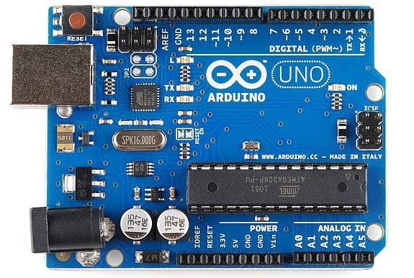
Technology used
Arduino Uno
The main piece in technology used is an arduino ATmega328 kit

Slide 6
Microcontroller | ATmega328
Operating Voltage | 5V
Input Voltage (recommended) | 7-12V
Input Voltage (limits) | 6-20V
Digital I/O Pins | 14 (of which 6 provide PWM output)
Analog Input Pins | 6
DC Current per I/O Pin | 40 mA
DC Current for 3.3V Pin | 50 mA
Flash Memory | 32 KB (ATmega328) of which 0.5 KB used by bootloader
SRAM | 2 KB (ATmega328)
EEPROM | 1 KB (ATmega328)
Clock Speed | 16 MHz

Slide 7
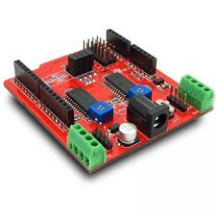
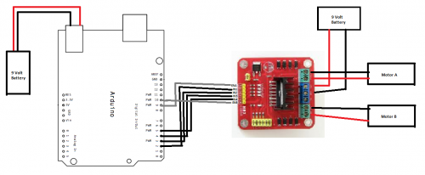
Motor Drive module

Slide 8
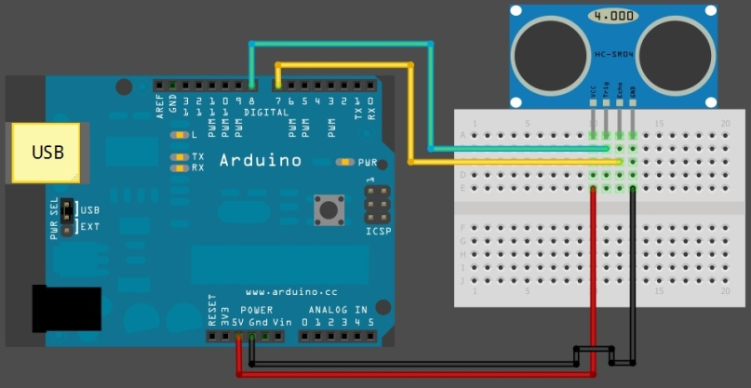
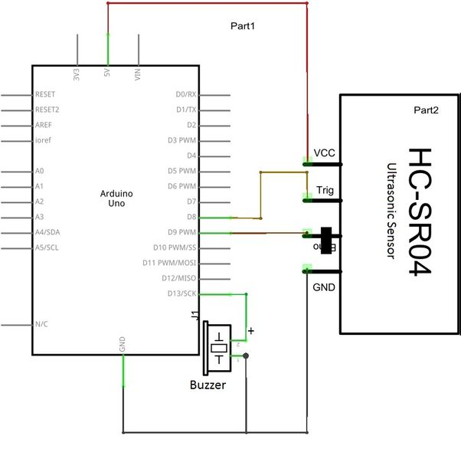
Obstacle detection Module

Slide 9
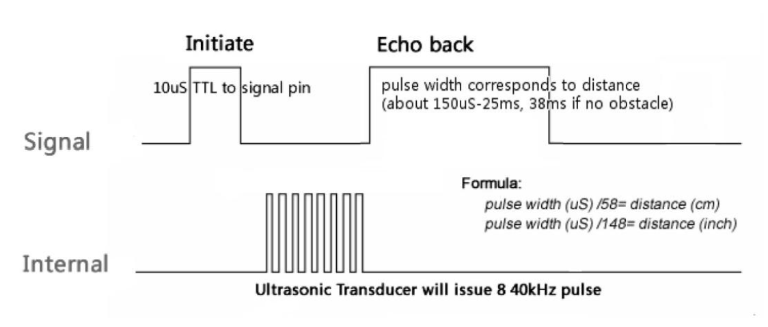
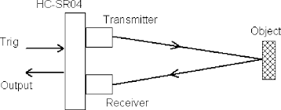
How to Work HC-SR04 sensor

Slide 10
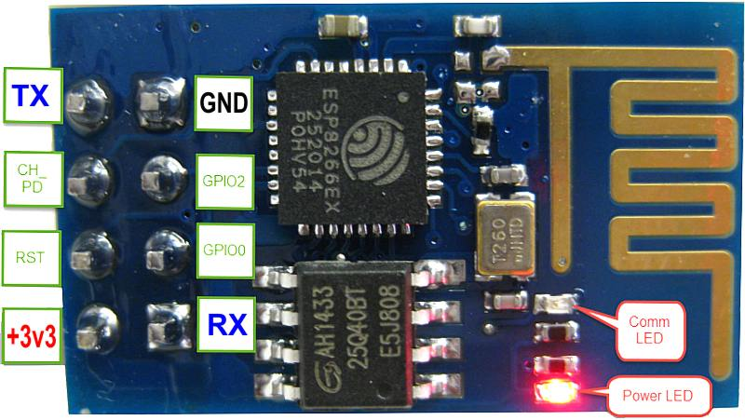
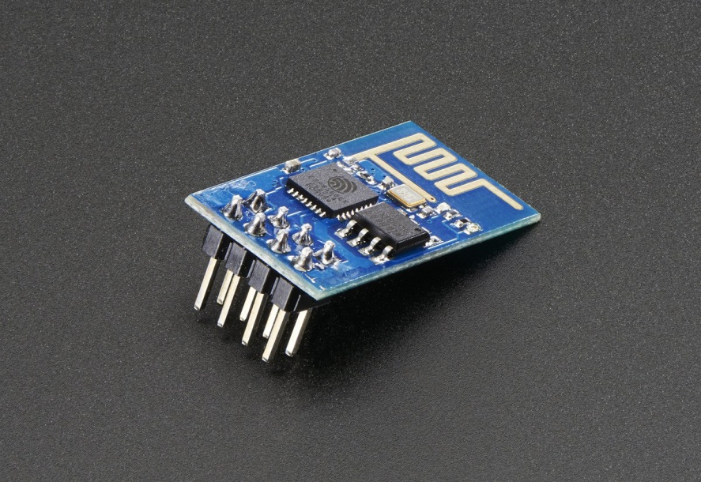
Wi-Fi Module
For the communication between mobile phone and microcontroller Wi-Fi module(ESP8266) is used.

Slide 11
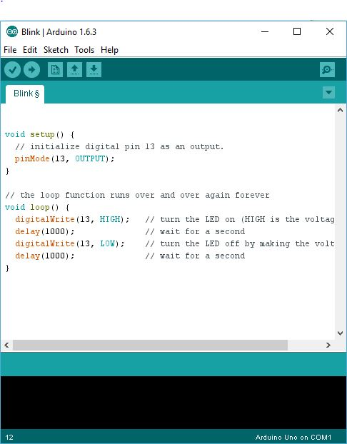
Software

Slide 12
Language:-
Arduino programs are written in C/C++, although users only need define two functions to make a runnable program:
setup() – a function run once at the start of a program that can initialize settings loop() – a function called repeatedly until the board powers off
#define LED_PIN 13
void setup ()
{
pinMode (LED_PIN, OUTPUT); // enable pin 13 for digital output
}
void loop ()
{
digitalWrite (LED_PIN, HIGH); // turn on the LED
delay (1000); // wait one second (1000 milliseconds)
digitalWrite (LED_PIN, LOW); // turn off the LED
delay (1000); // wait one second
}

Slide 13
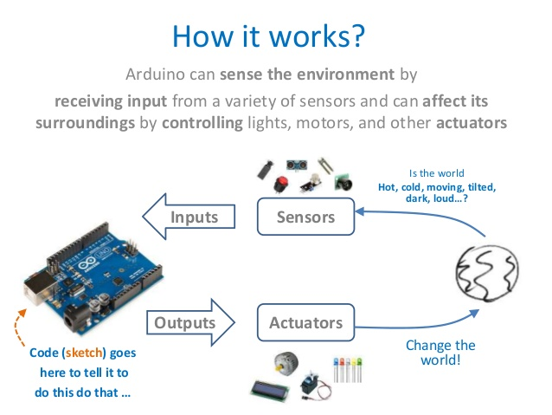
How it works

Slide 14
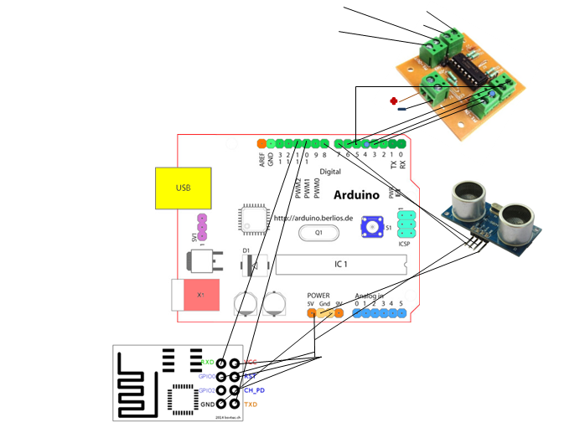
Circuit Diagram

Slide 15
Applications
Remote control
Automatic obstacle avoidance
Smart Operations
Security Systems

Slide 16
Advantages
Adds Safety through obstacle identification.
Saves Time.
Saves Life.

Slide 17
Advantages (cont.….)
Increases range to control the car .
Wireless
Virtual Driver.
Reduces collision.

Slide 18
Scope
New Era in Car technology.
Car control goes wireless.
Industries , gaming, mission operations
commands through computer or smartphone via Wi-Fi .

Slide 19






DEMO…..

Slide 20
Thank You…… ☺
Any Questions……………

